Slide 1
Azure Architect Workshop Azure IoT Services Overview

Slide 2
IoT is an Inflection Point
Hardware
is cheap
Connectivity
is pervasive
Development
is easy
Huge benefits
fuel demand
New Innovative Scenarios

Slide 3
What if we were just a little more efficient?
Segment
Type of Savings
Est. Value in 15 Years (US/EU)
1% Reduction in Capital Expenditures
1% Reduction in Capital Expenditures
Gas-Fired Generation
1% Reduction in System Inefficiency
System-wide
1% Fuel Savings
$ 66B / $ 15B
System-wide
$ 27B / $ 6B
Commercial
1% Fuel Savings
$ 90B / $ 10B
System-wide
$ 30B / $ 9B
$ 63B / $ 15B
GE, Industrial Internet, A European Perspective, Pushing the Boundaries of Minds and Machines
GE, Industrial Internet: Pushing the Boundaries of Minds and Machines

Slide 4















Microsoft Azure IoT services
Devices | Device Connectivity | Storage | Analytics | Presentation & Action
 | Event Hubs | SQL Database | Machine Learning | App Service
 | Service Bus | Table/Blob Storage | Stream Analytics | Power BI
 | External Data Sources | DocumentDB | HDInsight | Notification Hubs
 |  | External Data Sources | Data Factory | Mobile Services
 |  |  |  | BizTalk Services
{ }

Slide 5
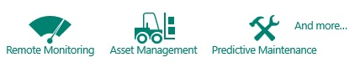
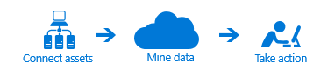
Azure IoT Suite
Accelerate time-to-value by easily deploying IoT applications for the most common use cases, such as remote monitoring, asset management, and predictive maintenance
Plan and budget appropriately through a simple predictable business model
Grow and extend solutions to support millions of assets

Slide 6









Microsoft Azure IoT Suite
Accelerate your business transformation
Azure IoT services
Azure IoT Suite
Enables you to
Connect assets
Mine data
Take action
Addresses
common scenarios:
Monitoring
Remote Monitoring
Asset Management
Predictive Maintenance
And more…

Slide 7
IoT Device & Cloud Patterns
Cloud Gateway
Event Hubs
Event Hubs
High scale telemetry ingestion service
HTTP/AMQP protocol support
Each Event Hub supports
1 million publishers
1GB/s ingress
Generally available worldwide
18 Billion messages per day
60+ TB ingested per day
Field Gateway
Protocol Adaptation
Devices
RTOS, Linux, Windows, Android, iOS
Field Gateway
Device
Connectivity & Management

Slide 8
IoT Device & Cloud Patterns
Cloud Gateway
Event Hubs
Additional IoT Needs
Command & control
Device identity
Device registry
Device management
Field Gateway
Protocol Adaptation
Devices
RTOS, Linux, Windows, Android, iOS
Coming with the Azure IoT Suite…
Field Gateway
Device
Connectivity & Management

Slide 9
IoT Device & Cloud Patterns
Cloud Gateway
Event Hubs
&
IoT Hub
IoT Hub
Capability of the Azure IoT Suite
Bi-directional device <-> cloud
Up to 10 million devices
Telemetry ingestion
Command & control
Device registry & identity
Device Management
HTTP/AMQP
Extensible protocol support / MQTT
Protocol Adaptation
Field Gateway
Protocol Adaptation
Devices
RTOS, Linux, Windows, Android, iOS
Field Gateway
Device
Connectivity & Management

Slide 10
IoT Device & Cloud Patterns
Cloud Gateway
Event Hubs
&
IoT Hub
Cross-Platform
Device Support
Open source “agent” framework
Simple, secure device <-> cloud connectivity & management
RTOS, Linux, Windows, Android, iOS
Easy to use, not required
Protocol Adaptation
Field Gateway
Protocol Adaptation
Devices
RTOS, Linux, Windows, Android, iOS
Field Gateway
C API
.NET API
Java API
Javascript API
Cross Platform C Code
Device
Connectivity & Management
OS Abstraction Layer / OS Bindings

Slide 11

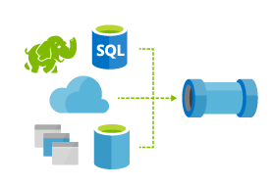
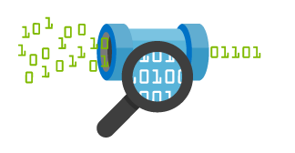

IoT Device & Cloud Patterns
Find insights to
Power new services
Improve your “things”
Batch Analytics & Visualizations
Azure HDInsight, AzureML, Power BI,
Azure Data Factory
Cloud Gateway
Event Hubs
&
IoT Hub
Hot Path Analytics
Azure Stream Analytics, Azure HDInsight Storm
Protocol Adaptation
Hot Path Business Logic
Service Fabric & Actor Framework
Operationalize your insights in real time
Field Gateway
Protocol Adaptation
Devices
RTOS, Linux, Windows, Android, iOS
IoT Scale
Object Models & Business Logic
Field Gateway
Device
Connectivity & Management
Analytics &
Operationalized Insights

Slide 12
IoT Device & Cloud Patterns
Batch Analytics & Visualizations
Azure HDInsight, AzureML, Power BI,
Azure Data Factory
Cloud Gateway
Event Hubs
&
IoT Hub
Hot Path Analytics
Azure Stream Analytics, Azure HDInsight Storm
Presentation &
Business Connectivity
App Service, Websites
Dynamics, BizTalk Services, Notification Hubs
Protocol Adaptation
Hot Path Business Logic
Service Fabric & Actor Framework
Field Gateway
Protocol Adaptation
Devices
RTOS, Linux, Windows, Android, iOS
Field Gateway
Device
Connectivity & Management
Analytics &
Operationalized Insights
Presentation &
Business Connectivity

Slide 13
Key Learnings
Cloud services are a scalable economic platform for IoT solutions
Organizations desire a default configuration of core services
Architecture flexibility is required for
Data ingress/egress options
Event processing and data flow customization
Analytics
Storage options
3rd Party integration

Slide 14
Reference Architecture Guiding Principles
Secure, scalable device centric data collection and analysis
Support for public, private, and hybrid Azure cloud environments
Initial focus on Public Cloud infrastructure
Frictionless information flow between LoB Assets and cloud-based systems for:
Analysis
Control
Business process integration
Direct or indirect (via gateway) connectivity support
Remote (gateway) device and data administration
Device provisioning, connectivity, protocol translation etc.

Slide 15
How does Partitioned Consumer work?
Event Processor Host:
A smart agent for reading events with automatic load distribution and check-pointing
Azure Event Hub
IEventProcessor
Event Processor Host
Direct
Partition 1
Consumer Group
Event Receivers
> 1M Producers > 1GB/sec Aggregate Throughput
Partition 2
Partitions
Partition 3
Partition 4
PartitionKey
Event Producers
AMQP
HTTPS
Hash
Partition 5
Partition 6
Partition 7
Consumer Group 2
Throughput Units:
1 ≤ TUs ≤ Partition Count
1 MB/sec or 1,000 events/sec ingress
2 MB/sec or 2,000 events/sec egress
TUs are billed by the hour
Partition 8
Up to 32 partitions via portal, more on request up to 1024
Define the maximum degree of downstream parallelism
Consumer Groups:
A view on the event stream
Can create up to 20 named consumer groups
AMQP

Slide 16
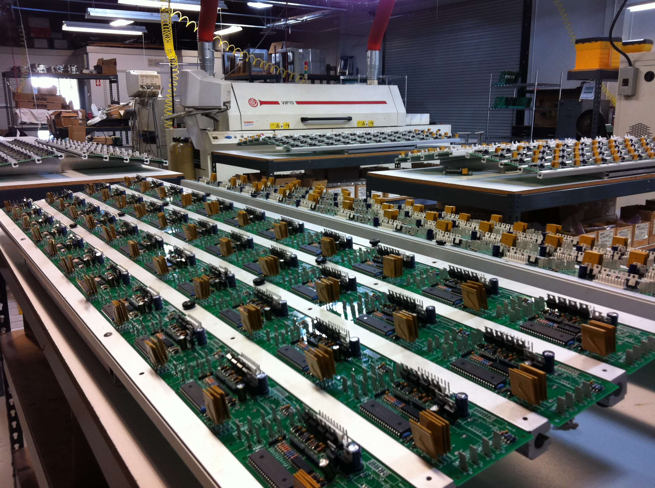
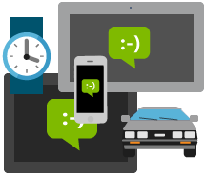

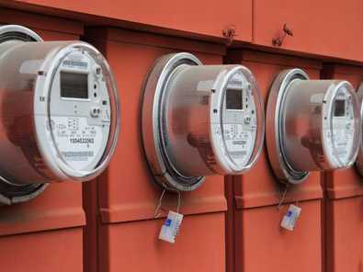

Azure Stream Analytics
Common Use Cases
Preventive Maintenance (Manufacturing, Auto, Utilities, Vending Machines, Datacenter)
Fraud Detection (Finance, Software, Telecom, Security)
Supply Chain Efficiency (Travel, Retail, Manufacturing)
Reduced Plant Downtime (Manufacturing – Robotics)
Customer Service Enhancement (Auto – Safety & Service, Retail, Customer Support)
Product Recommendation / Offers (Retail – online & offline)
Product and Service Quality Improvement (Agriculture, Online Software – Log Processing)
Many more…
Alerts / Emails / Text
Dashboards (web/ phone/tablet)
Command & Control Action
Downstream Workflow & Apps
Stream Analytics
Event Processing Engine to analyze and process in real-time fashion a large volume of high velocity streaming data coming from a variety of sources.
Fully managed, highly available and resilient.
Very rapid development and setup.
Low cost to manage and develop.
Store in Hadoop, SQL, Blob etc for later historical analysis
Machine Learning

Slide 17


End-to-End Architecture Overview
Stream Analytics
Outputs
SQL Azure
Azure Blobs
Event Hub
Azure Tables
PowerBI (Preview)
Constantly adding many more
Temporal Semantics
Guaranteed delivery
Guaranteed up time
Transform
Temporal joins
Filter
Aggregates
Projections
Windows
Etc.
Enrich
Correlate
Call ML models

Event Inputs
Event Hub
Azure Blob
BI Dashboards
Predictive Analytics

Reference Data
Azure Blob
…
Storage
Downstream
Systems
Data Source
Collect
Process
Deliver
Consume

Slide 18
Azure IoT Services Reference Architecture
Devices and Data Sources
Data Transport
Device and Event Processing
Presentation
Azure Event Hubs & Service Bus
Data Visualization & Presentation
IP capable devices
Provisioning API
Solution Portal
Device State Store
Agent
Identity & Registry Stores
Existing IoT devices
Stream Event Processor
Agent
Gateway
Storage
Analytics/ Machine Learning
Low power devices
Agent

Slide 19
Azure IoT Services Reference Architecture (2)
Devices and Data Sources
Data Transport
Device and Event Processing
Presentation
Azure IoT Hub
Data Visualization & Presentation
IP capable devices
Provisioning API
Solution Portal
Device State Store
Agent
Device Registry Store
Existing IoT devices
Stream Event Processor
Agent
Gateway
Storage
Analytics/ Machine Learning
Low power devices
Agent

Slide 20
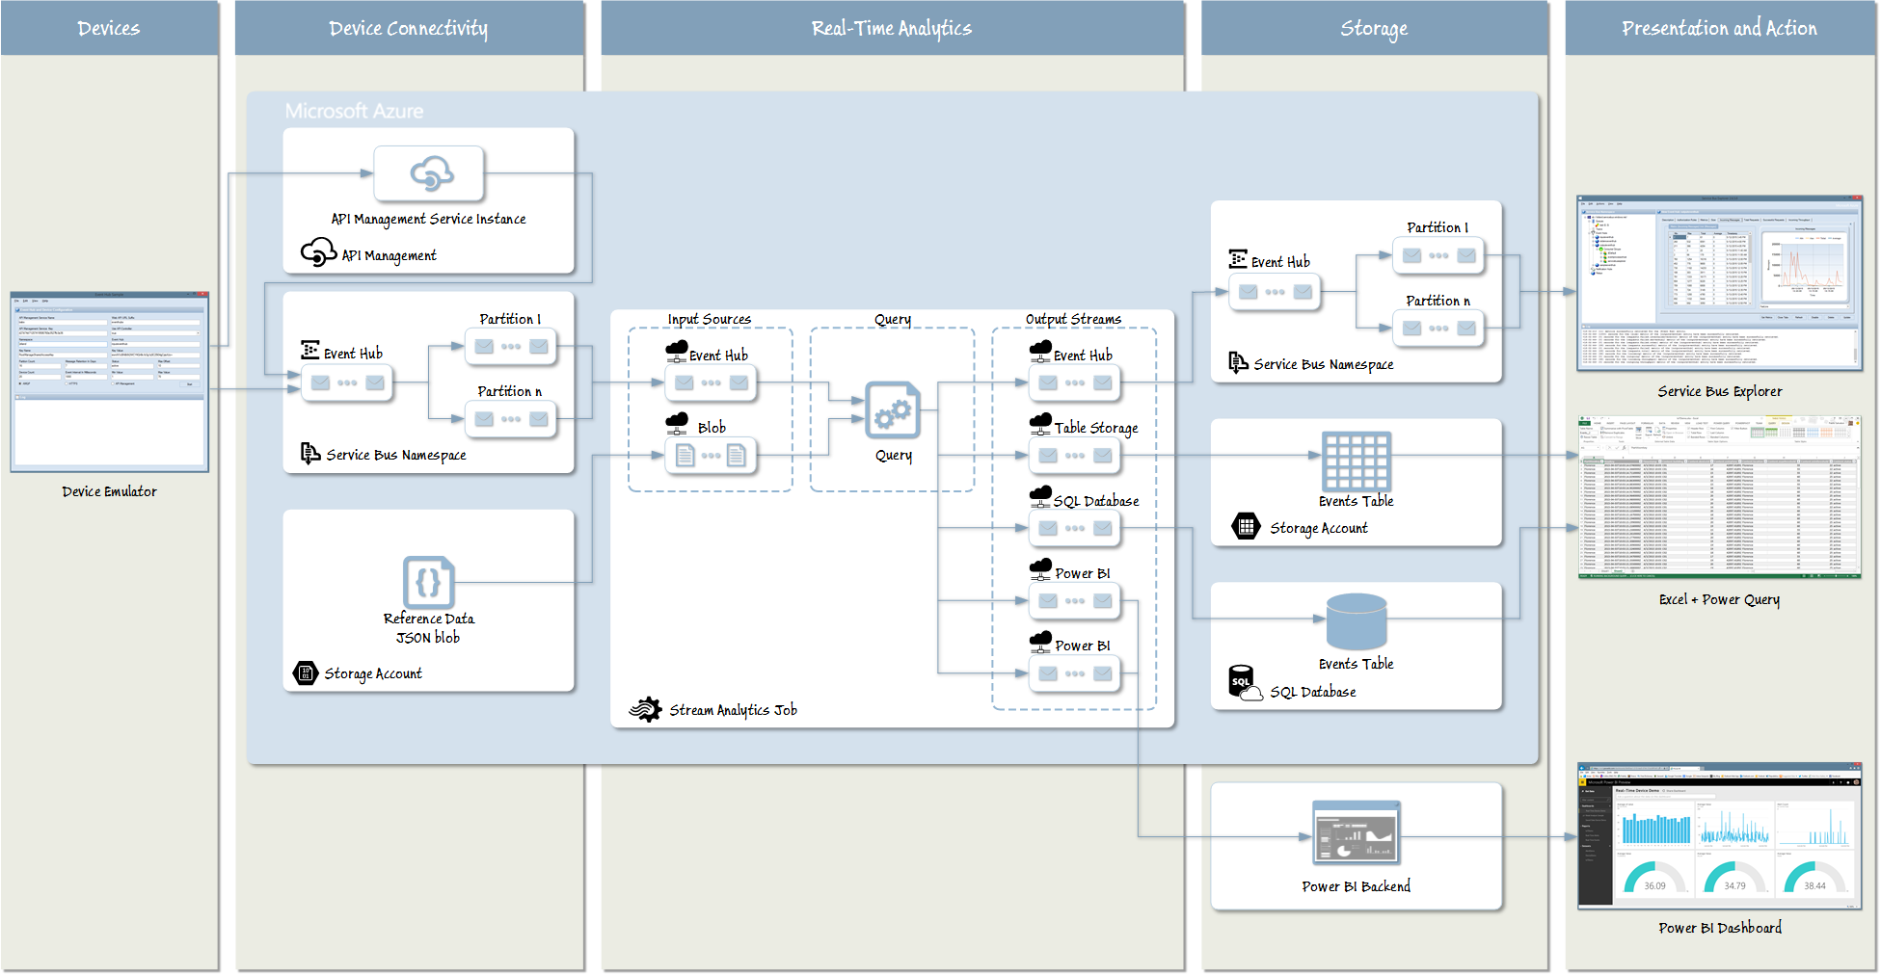
A sample scenario

Slide 21
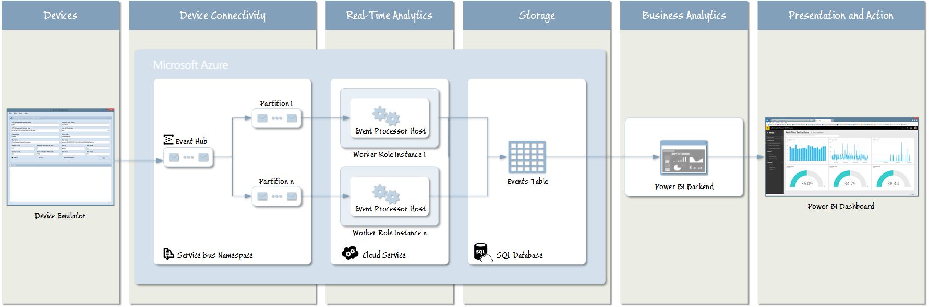
A sample scenario

Slide 22
Azure IoT Suite SDKs
Device-facing
For devices and field gateway
Platforms
RTOS (FreeRTOS)
Linux (Ubuntu, Debian, Fedora, Raspbian, Angstrom)
Windows 7/8/10
ARM mbed
Android
iOS
Languages
C, Java, C#, Javascript
Service-facing
For back-ends and cloud gateway
Languages
.NET C#
Java
Node

Slide 23
A sample scenario
Simulated wind turbine
Emits telemetry every second
State machine (Starting→Started→Stopping→Stopped)
Provision device
Device registry to query devices and track provisioning
Device identity and key stored in IoT hub
Device emits telemetry
Event processor receives telemetry and updates portal visualization
Send commands
Portal sends commands to devices
Command lifecycle is stored in device registry
Event Processor
IoT hub
Device id
D2C receive endpoint
D2C send endpoint
C2D send endpoint
Device data
C2D queue
Device …
Device …
Portal
Device identity management
Device …

Slide 24
Questions and Feedback

Slide 25

© 2014 Microsoft Corporation. All rights reserved. Microsoft, Windows, Windows Vista and other product names are or may be registered trademarks and/or trademarks in the U.S. and/or other countries.
The information herein is for informational purposes only and represents the current view of Microsoft Corporation as of the date of this presentation. Because Microsoft must respond to changing market conditions, it should not be interpreted to be a commitment on the part of Microsoft, and Microsoft cannot guarantee the accuracy of any information provided after the date of this presentation. MICROSOFT MAKES NO WARRANTIES, EXPRESS, IMPLIED OR STATUTORY, AS TO THE INFORMATION IN THIS PRESENTATION.

